Slide 1
Integrating Concepts in Biology
PowerPoint Slides for Chapter 9:
Evolution of Populations
by
A. Malcolm Campbell, Laurie J. Heyer, and Chris Paradise

Slide 2
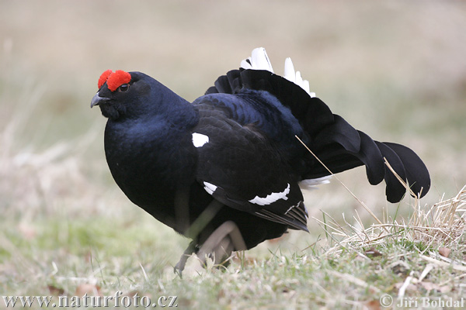
Black grouse
Front art piece UN9.1
Notes:
Front art piece UN9.1 Declines in populations of black grouse in Europe led to loss of genetic diversity.

Slide 3
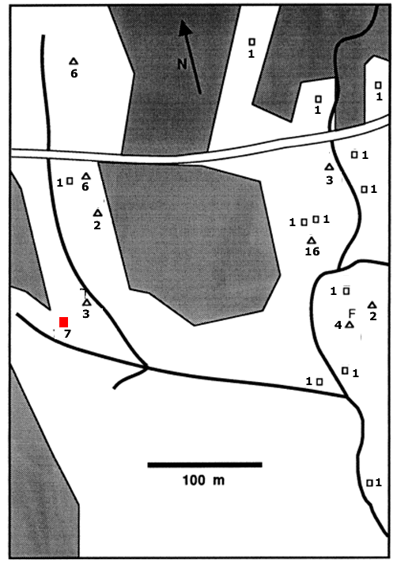
Figure 9.1
Notes:
Figure 9.1 Spatial structure of a fungus population in a forest, showing downed logs (squares and triangles), and the number of distinct genetic types of fungus at each log. Solid lines indicate locations of streams, while shading indicates non-forested areas. The red square is log R, which is shown in detail in Figure 9.2.

Slide 4
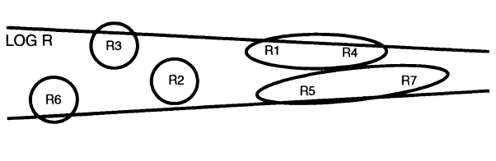
Figure 9.2
Notes:
Figure 9.2 Distribution of genetic types in a fungus inhabiting a rotting log whose location is indicated by the red square in Figure 9.1. Groups of genetically similar individuals are circled.

Slide 5
Figure 9.2 Distribution of genetic types in a fungus inhabiting a rotting log (R in Figure 9.1)
Groups of genetically similar individuals are circled.
Figure 9.2
Notes:
Figure 9.2 Distribution of genetic types in a fungus inhabiting a rotting log whose location is indicated by the red square in Figure 9.1. Groups of genetically similar individuals are circled.

Slide 6
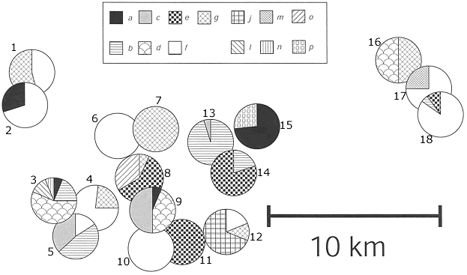
Figure 9.3
Notes:
Figure 9.3 Distribution of 13 mitochondrial allele combinations among 18 populations of bladder campion, with each pie chart representing the geographic location and frequency of different mitochondrial allele combinations. Numbers are arbitrarily assigned to each population.

Slide 7
Figure 9.4 Frequency histogram of juvenile starling dispersal distances. Note that the x-axis has a discontinuous scale.
Figure 9.4
Notes:
Figure 9.4 Frequency histogram of juvenile starling dispersal distances. Note that the x-axis has a discontinuous scale.

Slide 8
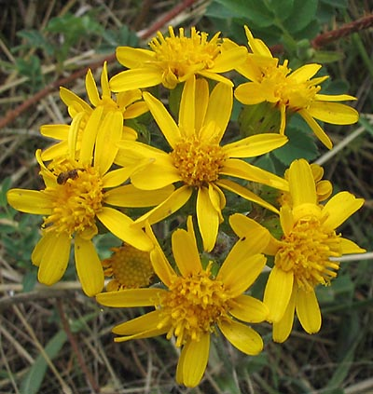
Figure 9.5
Notes:
Figure 9.5 Groundsel (Senecio integerrimus), found in the Colorado Rockies. Note the bee on the flower at the 9 o’clock position.

Slide 9
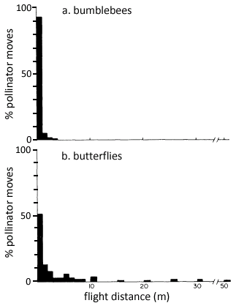
Distribution of flight distances for bumblebees and butterflies visiting flowers
Figure 9.6
Notes:
Figure 9.6 Distribution of flight distances for bumblebees and butterflies visiting flowers.

Slide 10
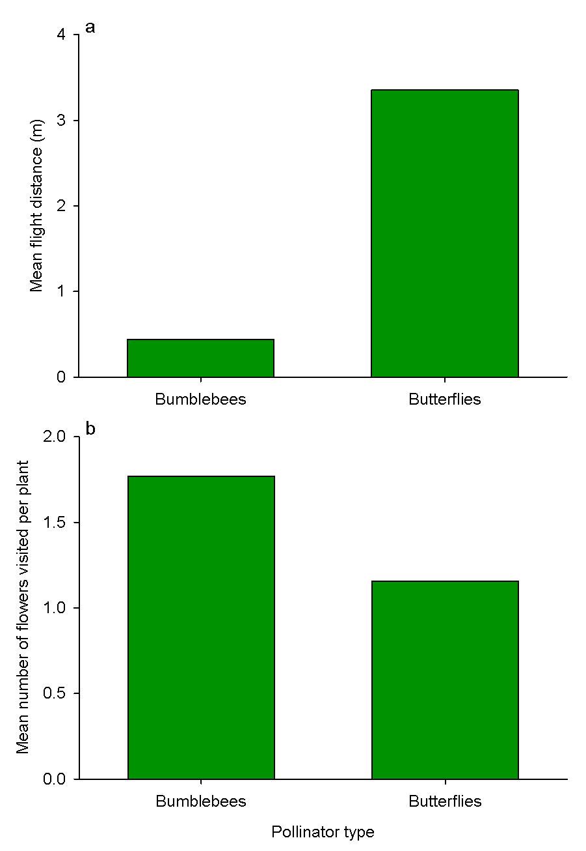
Figure 9.7
Notes:
Figure 9.7 Mean flight distance (a) and number of flowers visited per plant (b) for bumblebees and butterflies.

Slide 11
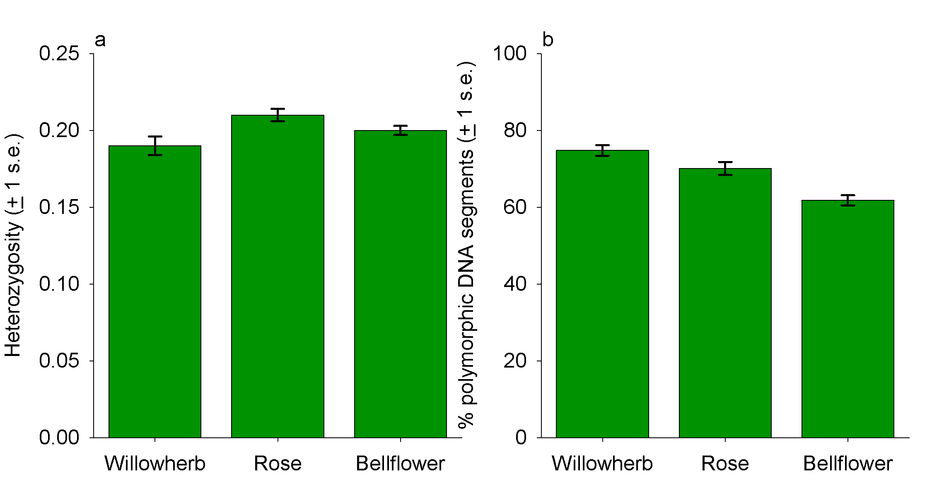
Figure 9.8
Notes:
Figure 9.8 Heterozygosity and multiple alleles in plant populations in the Swiss Alps. a. Heterozygosity, indicating the number of genes within a population that were heterozygous, averaged over all genes and all individuals within a population. b. The mean percentage of loci within a population that had multiple alleles, averaged over all populations sampled.

Slide 12
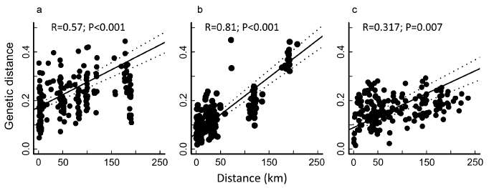
Figure 9.9
Notes:
Figure 9.9 Genetic distances for each pair of populations, with a best fit regression line fit through the data (solid line), with 95% confidence interval for the best fit line (dotted lines). a. Alpine willowherb. b. Rose-like plant. c. Yellow bellflower.

Slide 13
Figure 9.10
Notes:
Figure 9.10 Locations of nine populations of the orchid Amitostigma gracile in South Korea. The lower left map is an expansion of the box in the upper map labeled AM-1 ~ AM-5, and the lower right map is an expansion of the box in the lower left map labeled AM-1 ~ AM-4. Pie-charts attached to each population’s location indicate the frequency of two alleles of diaphorase. A third allele was found in population AM-3, but at low frequency (0.014).

Slide 14
Figure 9.11
Notes:
Figure 9.11 Change over time in number of displaying black grouse cocks and the number of occupied breeding areas in the Netherlands from 1940 to 2007.

Slide 15
 | Dutch museum | Norway | Austria
Dutch present | 0.111 (0.062-0.177) | 0.160 (0.124-0.193) | 0.152 (0.108-0.194)
Dutch museum |  | 0.050 (0.011-0.109) | 0.036 (0.006-0.078)
Norway |  |  | 0.031 (0.013-0.050)
Notes:
Table 9.1. Estimates of genetic distance among four populations of black grouse in Europe. Numbers in parentheses are the 95% confidence intervals for the estimates. From Larsson et al.

Slide 16
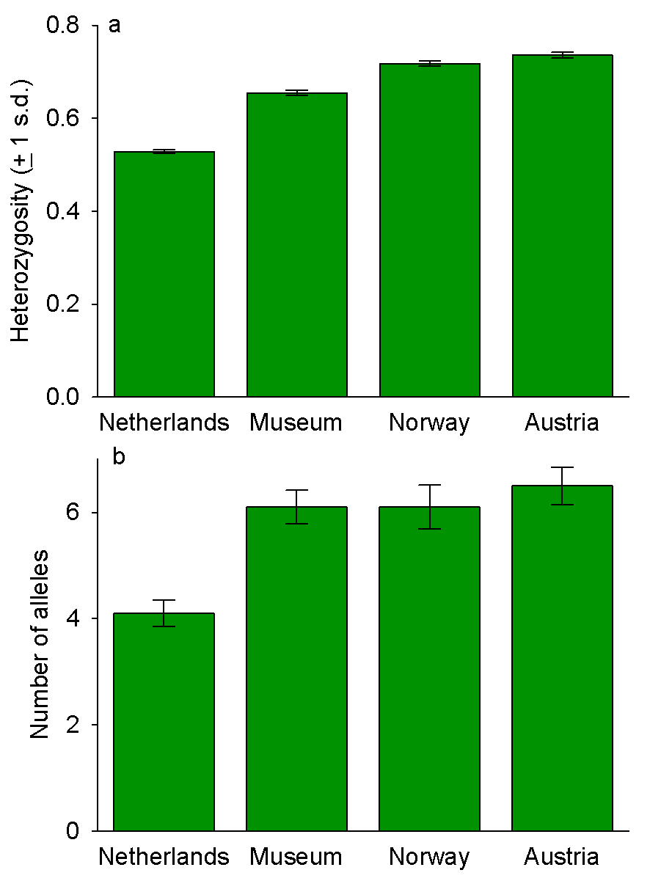
Figure 9.12
Notes:
Figure 9.12 Estimates of genetic diversity, as measured by heterozygosity and number of alleles, in four black grouse populations. The museum population estimated values for the Dutch population in the past, and the Norway and Austrian populations were current, but larger populations. Values are averages (with standard deviation error bars).

Slide 17
Figure 9.13
Notes:
Figure 9.13 Skull of Sahelanthropus tchadensis discovered in Chad. a. View from the front; note that skull has been compressed on one side. b. side view. c. View from above. d. View from below.

Slide 18
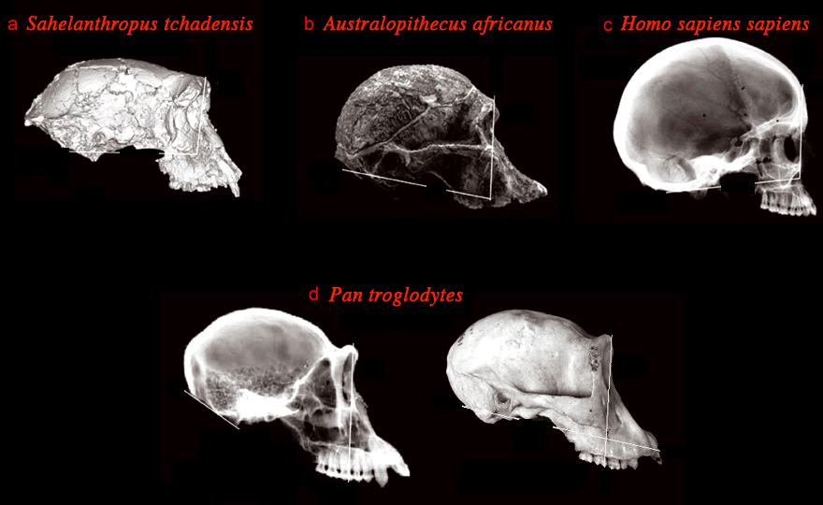
Figure 9.14
Notes:
Figure 9.14 Skulls of several hominids and chimpanzees. a. Sahelanthropus tchadensis discovered in Chad. b. Australopithecus africanus c. Homo sapiens, human. d. Two skulls of chimpanzees, Pan troglodytes.

Slide 19
 | Upper lip length (mm) | Upper canine thickness (mm) | Lower canine width (mm) | Lower canine thickness (mm) | Brow ridge thickness (mm)
Chad fossil* | 22 | 10.2 | 11.0 | 8.5 | 18.2
A. afarensis | 30 – 33 | 9.3 – 12.5 | 7.5 – 11.7 | 8.8 – 12.4
A. africanus | 21.1 – 30 |  |  |  | 6 – 10
P. boisei | 42.2
Homo habilis | 25 – 31
Homo sapiens |  | 6.5 – 7.7 | 6.5 – 10.4 | 1.8 – 10.1
Pan troglodytes |  | 9.5 – 11.8 | 7.0 – 17.9 | 11.4 | 5.2 – 11.8
Gorilla (gorilla) |  | 11.3 – 16.8 | 8.0 – 20.9 |  | 7.3 – 17.5
Notes:
Table 9.2. Skull measurements for unknown hominid fossil and several known species. If the range from multiple specimens is known, that is shown. Empty cells represent missing data. The upper lip length is the distance from the base of the nasal cavity to the base of the upper teeth. Canines are teeth. A. = Australopithecus, P. = Paranthropus, Pan troglodytes is the chimpanzee.

Slide 20
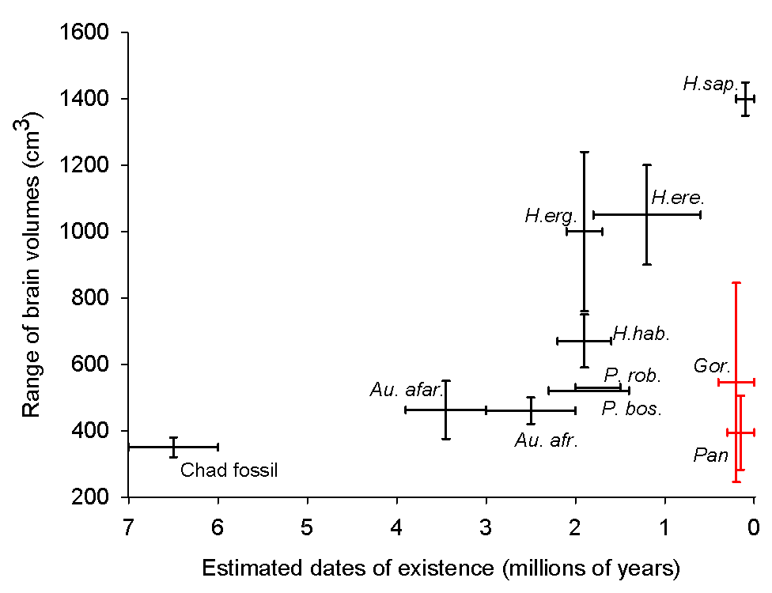
Figure 9.15
Notes:
Figure 9.15 Estimates of brain volume ranges from fossil evidence of a variety of hominid species and three living species. The fossil from Chad is at the lower left, and extinct hominids are also shown (Australopithecus afarensis (Au. afar.), Australopithecus africanus (Au. afr.), Paranthropus boisei (P. bos.), Paranthropus robustus (P. rob.), Homo habilis (H. hab.), Homo ergaster (H. erg.), Homo erectus (H. ere.)). Modern humans, Homo sapiens (H. sap.), chimpanzees (Pan) and gorillas (Gor.) are shown for comparison.

Slide 21
Figure 9.16
Notes:
Figure 9.16 This figure represents the known fossil record of hominids, including humans (top left) and chimpanzees (top right). The height of a bar represents the dates of the earliest and latest fossil evidence. Species are grouped by brain and tooth size, and posture and locomotion inferred by skeletal evidence. Obligate bipedal organisms must walk on two legs; facultatively bipedal organisms can walk on two legs or using all four limbs, depending on circumstances and need. Species marked with an asterisk were unknown prior to 1990.

Slide 22
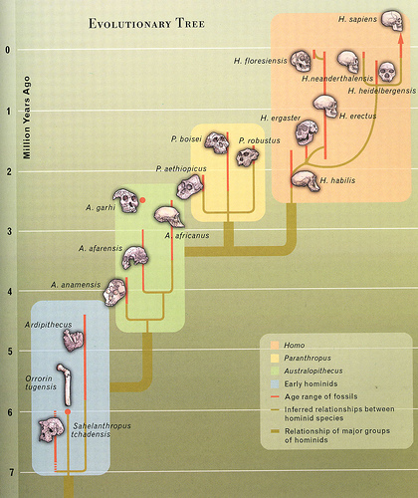
Figure 9.17
Notes:
Figure 9.17 Phylogenetic reconstruction of hominids; the human family tree. Note that age ranges of fossils are shown by red lines, and tan lines represent inferred relationships based on fossil evidence. Major groups are contained within colored boxes.

Slide 23
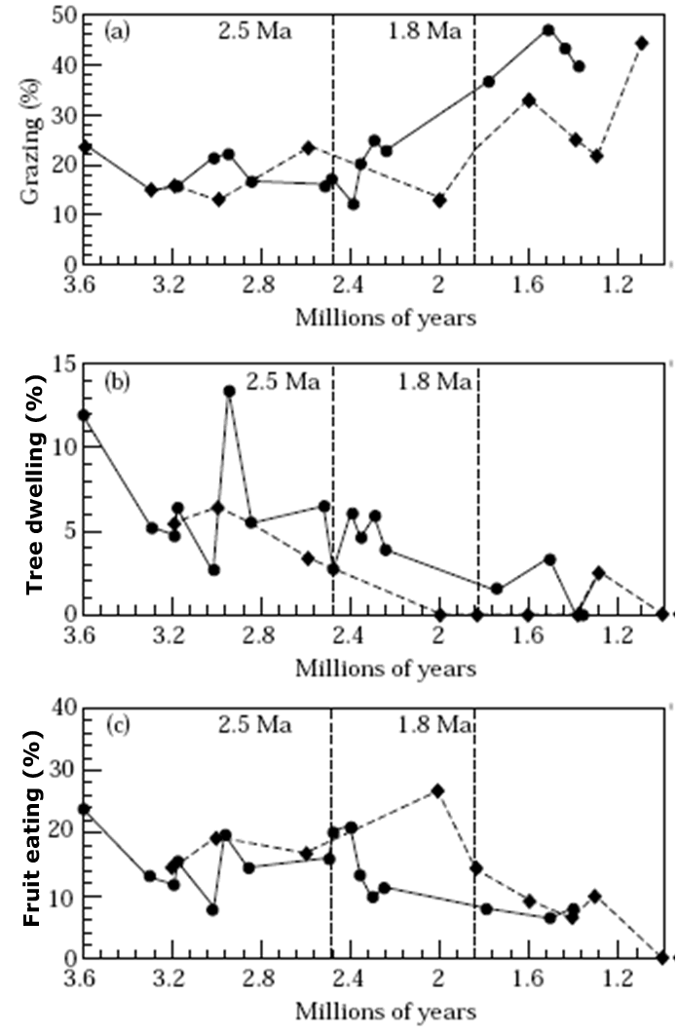
Figure 9.18
Notes:
Figure 9.18 Plot of the percentages of (a) grazing mammals, (b) tree-climbing/dwelling mammals, and (c) fruit eating mammals found in hominid fossil localities over time. The vertical dotted lines represent 2·5 and 1·8 million years ago (Ma = millions of years ago). Diamonds represent averages for east Africa locales, and circles represent averages for southern Africa locales.

Slide 24
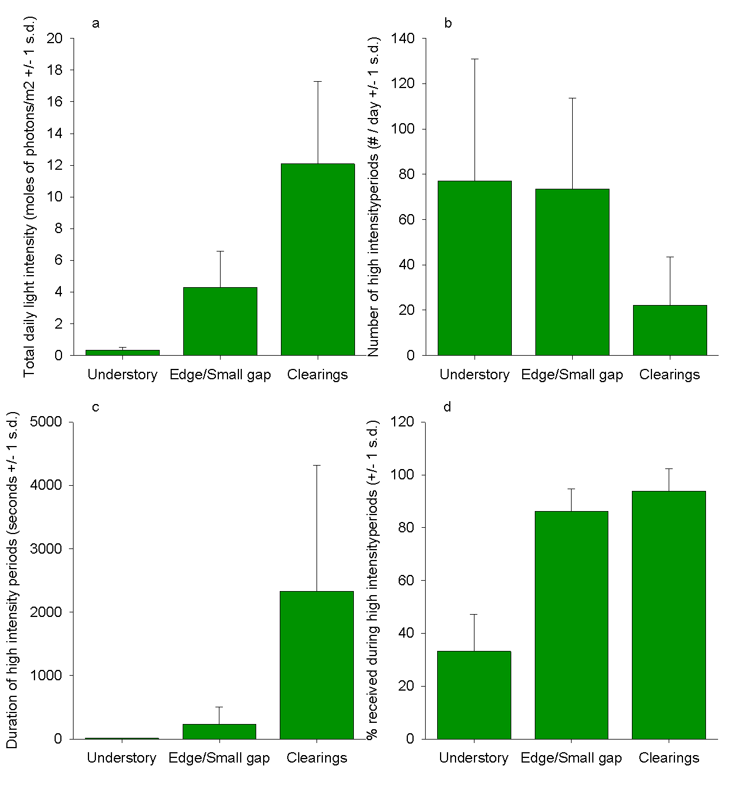
Figure 9.19
Notes:
Figure 9.19 Some properties of the light environment in the forest understory, near edges or small gaps, and in clearings in a Panama rainforest. a. Average total daily light photons, which is a quantitative measure of light intensity. b. Number of time periods that receive high light intensity, correlated with number of light flecks. c. Duration of high light intensity periods, a measure of the length of light flecks. d. Percentage of total light from panel a that was attributed to light flecks.

Slide 25
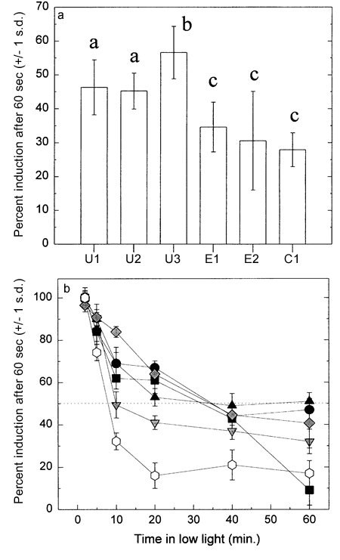
Figure 9.20
Notes:
Figure 9.20 Percentage of maximum induction after 60 second exposure to high light intensity. a. Leaves were kept in shade for at least 14 hours. Understory shrubs are U1-U3, Edge species are E1 and E2, and the open clearing specialist is C1. The letter above each bar indicates groups that were not significantly different from each other, as determined by statistical test, and different letters above two bars indicate significant difference. b. Leaves were kept in high light, followed by varying exposure times to shade, prior to exposure to high light intensity. Solid symbols are understory species, grey symbols are edge/gap species, and open symbols are for the clearing species. Values are means + 1 s.d.

Slide 26
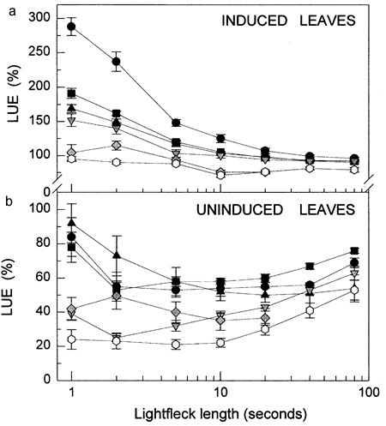
Figure 9.21
Notes:
Figure 9.21 Lightfleck use efficiency (LUE) as a function of the duration of light flecks. a. Means for leaves that had been induced with high light intensity to produce maximum photosynthesis response, followed by a period of time in shade, prior to light fleck exposure. b. Means for leaves that had not been induced prior to light fleck exposure. Solid symbols are understory species, grey symbols are edge/gap species, and open symbols are for the clearing species. Values are means + 1 s.d.

Slide 27
Light level | Light level where Ps = Resp | Light level of max. Ps | Max Ps rate | Resp rate in darkness
Low | 7 | 150 | 2.6 + 0.3 | 1.2 + 0.9
Medium-low | 10 | 200 | 3.3 + 0.4 | 1.4 + 0.2
Medium-high | 15 | 350 | 4.3 + 0.2 | 2.0 + 0.3
High | 20 | 600 | 5.4 + 0.6 | 2.5 + 0.2
Notes:
Table 9.3. Photosynthetic and respiration characteristics of hydrilla plants grown under several light levels. Light levels are µeinsteins/m²/sec, and rates are µmoles of CO₂/mg chlorophyll/hour. Values from first two columns are estimates from a best fit curve of carbon dioxide change vs. light level, and values from last two columns are means of 6 plants + 1 standard deviation.

Slide 28
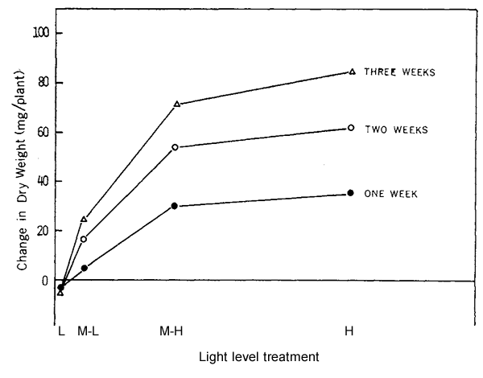
Figure 9.22
Notes:
Figure 9.22 Growth of hydrilla exposed to one of four light levels, expressed as change in dry mass. L = low, M-L = medium-low, M-H = medium-high, and H = high light. The distance separating each treatment on the x-axis is relative to the difference in the amount of light to which plants were exposed. Each point is the mean of 6 plants harvested at 1 week, 2 weeks, and 3 weeks.

Slide 29
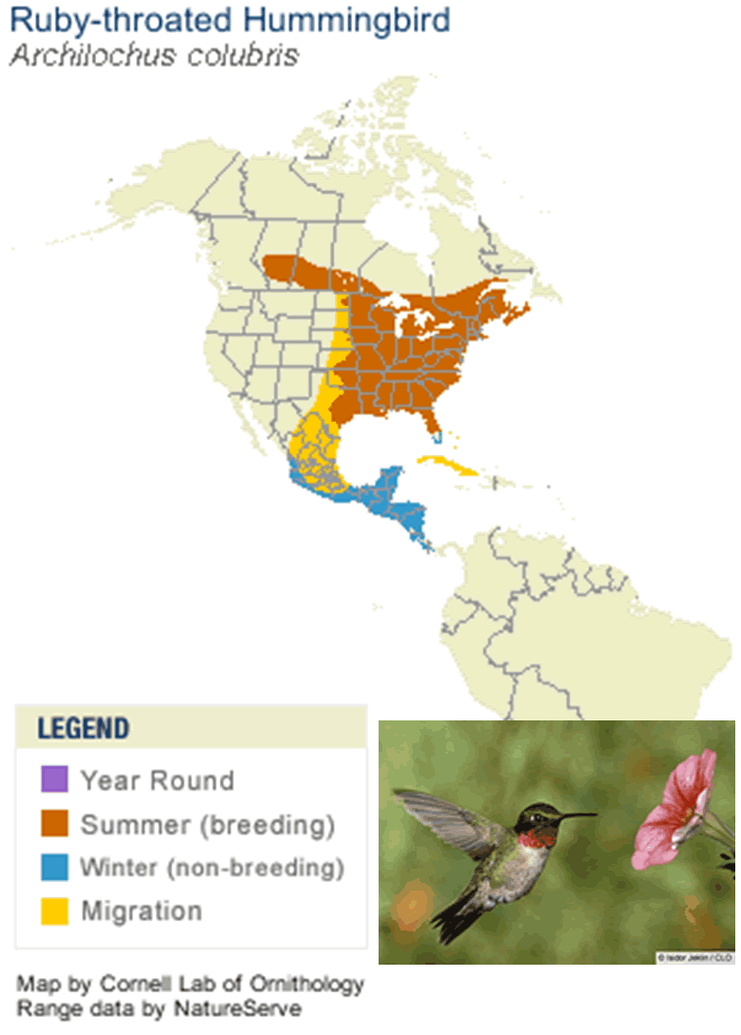
Figure 9.23
Notes:
Figure 9.23 Geographic range of the ruby-throated hummingbird, shown in inset.

Slide 30
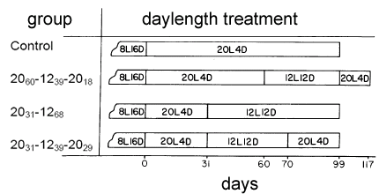
Figure 9.24
Notes:
Figure 9.24 Daylength treatments performed on groups of white-crowned sparrows in the second experiment of Farner and colleagues. Subscripts indicate the number of days at the specified daylength. Sample sizes ranged from 5 – 9 birds.

Slide 31
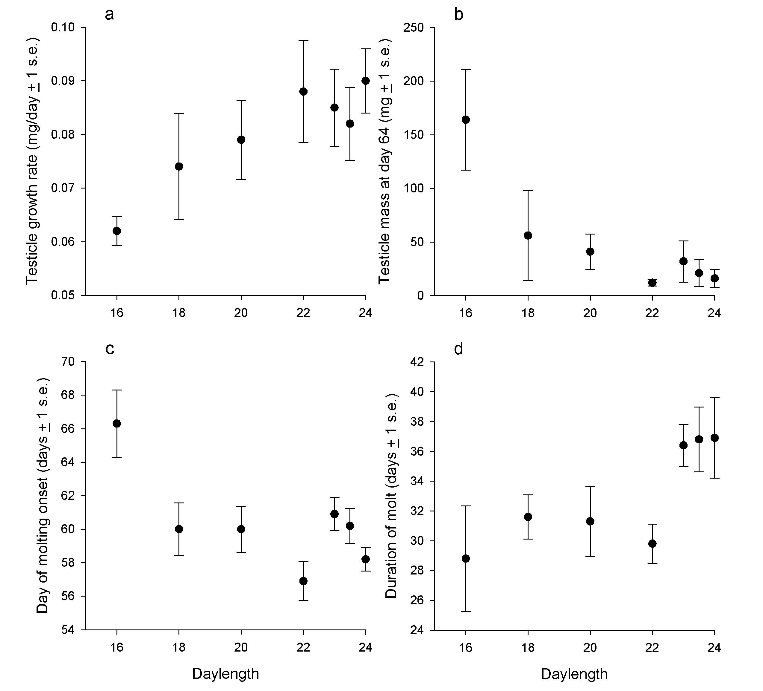
Figure 9.25
Notes:
Figure 9.25 The effect of daylength on various migration-related physiological parameters in white-crowned sparrows. a. Testicle growth rate. b. Combined testicle mass at day 64, after all males began to show testicle mass reduction. c. Average number of days after switching to longer daylength when primary feathers began to molt. d. Average duration of primary feather molt.

Slide 32
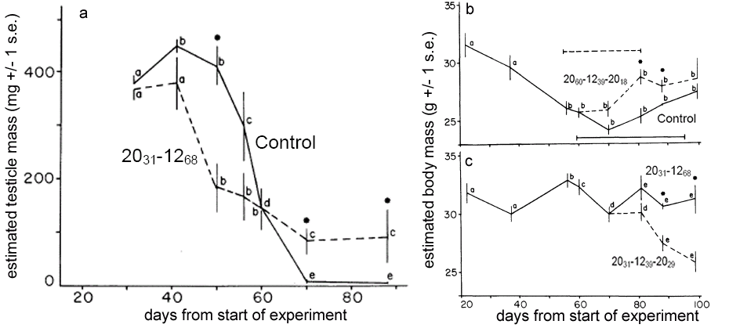
Figure 9.26
Notes:
Figure 9.26 Changes in testicular and body mass of male white-crowned sparrows over time. The treatments are as designated in Figure 9.24. a. Changes in testicular mass in control males vs. males in the 20₃₁-12₆₈ treatment. b. Body mass of males in the control and 20₆₀-12₃₉-20₁₈ treatment. Horizontal lines indicate duration of molt of primary flight feathers. For the first 60 days, both groups were in the same condition, and body masses are shown as one line. c. Body mass of males in 20₃₁-12₆₈ and the 20₃₁-12₃₉-20₂₉ treatments. For the first 70 days of the experiment both groups were in the same condition. For all panels, consecutive points with different superscripts are statistically different (P < 0.01). Asterisks indicate days on which treatment groups differed significantly. Values are means + 1 SE.

